Slide 1
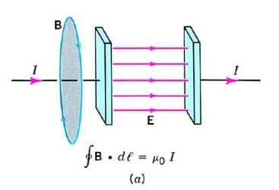
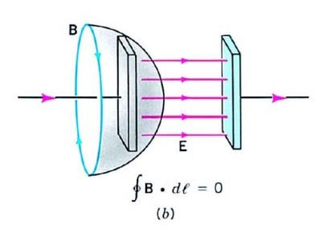
Maxwell’s Equations: Electromagnetic Waves
In 1845, Faraday demonstrated that a magnetic field produces a measurable effect on a beam of light. This prompted him to speculate that light involves oscillation of electric and magnetic field lines, but his limited mathematical ability prevent him from pursuing this idea.
Maxwell, a young admirer of Faraday, believed that the closeness of these two numbers, speed of light and the inverse square root of ε₀ and µ₀, was more than just coincidence and decide to develop Faraday’s hypothesis.
In 1865, he predicted the existence of electromagnetic waves that propagate at the speed of light.
1
Displacement Current
The inadequacy of the Ampere’s law does not give consistent answers for the following two choices.
Maxwell proposed that a new type of current, which he called
displacement current,
I , can be associated with the
D
nonconductor between the plates. Thus Ampere’s law should be
written as
∫B ⋅ dl = μ_{ο} (I + I_{D} )
2

Slide 2
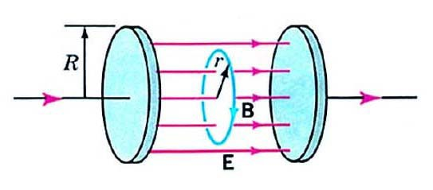
Displacement Current (II)
Where does the displacement current come from? The change of the electric flux with time.
Consider a parallel plate capacitor
Q = ε₀ AE = ε₀Φ _{E}
dQ _{= ε} dΦ _{E}
= I
0
D
dt dt
With Maxwell’s modification, Ampere’s law becomes
∫ B ⋅ dl = μ₀ (I + ε₀
dΦ _{E}
)
dt
3
Example 1
Use the Ampere-Maxwell law to find the magnetic field between the circular plates of a parallel-plate capacitor that is charging. The radius of the plates is R. Ignore the fringing field.
Solution:
∫ B ⋅ dl = B(2πr)
Φ = E(πr ² )
E
B(2πr) = μ ε (πr ² ) ^{dE}
0 0
dt
B = ¹ μ ε r ^{dE} (r < R)
0 0
2 dt
4

Slide 3
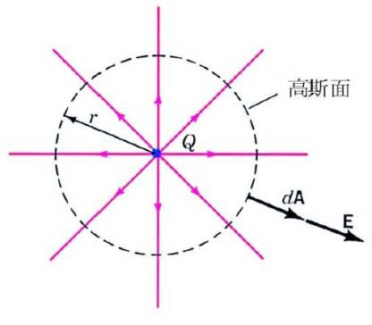
Maxwell’s Equations
With the inclusion of Maxwell’s contribution, we now display all the fundamental equations in electromagnetism. There are just four:
Q
Gauss
∫ E ⋅ dA = _{ε}
0
Gauss
∫ B ⋅ dA = 0
Faraday
∫
∫
dΦ
E ⋅ dl = − ^{B}
dt
Ampere- Maxwell
B ⋅ dl = μ (I + ε
dΦ _{E )}
0
0
dt
5
Gauss’s Law
How much is the flux for a spherical Gaussian surface around a point charge?
The total flux through this closed Gaussian surface is
Φ = E ⋅ nˆ da = ^{kQ} ⋅ 4π r ²
E
∫
_{r} 2
= 4πKQ = ^{Q}
ε ₀
The net flux through a closed surface equals 1/ε₀ times the net charge enclosed by the surface.
Can we prove the above statement for arbitrary closed shape?
6

Slide 4
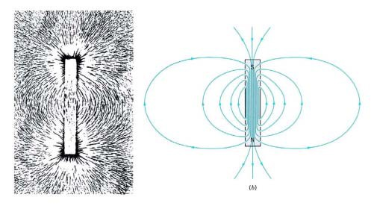
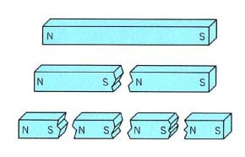
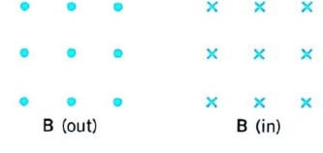
The Magnetic Field
When iron filings are sprinkled around a bar magnet, they form a characteristic pattern that shows how the influence of the magnet spreads to the surrounding space.
The magnetic field, B, at a point along the tangent to a field line. The direction of B is that of the force on the north pole of a bar magnet, or the direction in which a compass needle points. The strength of the field is proportional to the number of lines passing through a unit area normal to the field (flux
density).
7
The Magnetic Field: monopole?
If one try to isolate the poles by cutting the magnetic, a curious thing happens: One obtains two magnets. No matter how thinly the magnet is sliced, each fragment always have two poles. Even down to the atomic level, no one has found an isolated magnetic pole, called a monopole. Thus magnetic field lines form closed loops.
Outside a magnetic the lines emerge from the north pole and enter the south pole; within the magnet they are directed from the south pole to the north pole. The dots represents the tip of an arrow coming toward you. The cross represents the tail of an arrow moving away.
8

Slide 5
Faraday’s Law and Lenz’s Law
The generation of an electric current in a circuit implies the existence of an emf. Faraday’s statement is nowadays expressed in terms of the magnetic flux:
V
∝ dΦ
EMF
dt
The induced emf along any closed path is proportional to the rate of change of magnetic flux through the area bounded by the path.
The derivative of magnetic flux is
^{dΦ} = ^{dB} A cosθ + B ^{dA} cosθ − BAsinθ ^{dθ} dt dt dt dt
9
Faraday’s Law
The emf is always opposite to the sign of the change in flux
ΔΦ. This feature can be incorporated into Faraday’s law by including a negative sign.
The modern statement of Faraday’s law of electromagnetic induction is
V
₌ ₋ dΦ
EMF
dt
Suppose that the loop is replaced by a coil with N turn. The net emf induced in a coil with N turns is
V = −N ^{dΦ}
EMF
dt
10

Slide 6
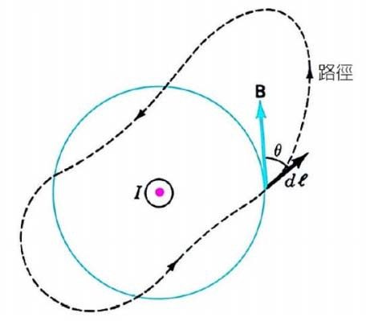
Ampere’s Law
Ampere had several objections to the work of Biot and Sarvart. For example, accuracy and assumption.
He pursued his own line of experimental and theoretical research and obtained a different relation, now called Ampere’s law, between a current and the magnetic field it produces.
Although Ampere’s law can be derived from the Biot-Sarvart expression for dB, we will not do so. Instead, we can make it plausible by considering the field due to an infinite straight wire.
We know that the field lines are concentric circles for a infinite long, straight current-carrying wire.
B(2πr)=μ₀I
11
Ampere’s Law (II)
B(2πr)=μ₀I. We may interpret it as follows: 2πr is the length of a circular path around the wire, B is the component of the magnetic field tangential to the path, and I is the current through the area bounded by the path.
Ampere generalized this result to the paths and wires of any shape.
12

Slide 7
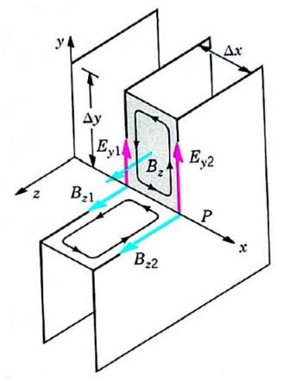
Derivation of the Wave Equation
Mathematical manipulation of Faraday’s law and Ampere- Maxwell law leads directly to a wave equation for the electric and magnetic field.
Faraday’s law | Ampere-Maxwell law
dΦ ∫ E ⋅ dl = − ^{B} dt | ∫ B ⋅ dl = μ (I + ε ^{dΦ E} ) 0 0 _{dt}
∇× E = − ^{∂B} ∂t | ∇× B = μ ε ^{∂E} 0 0 _{∂t}
2
∇× (∇× E) = − ^{∂(∇× B)}
⇒ ∇²E = μ ε
∂ E
∂t
0
⁰ ∂t ²
13
Derivation of the Wave Equation (II)
We will assume E and B vary in a certain way, consistent with Maxwell equations, and show that electromagnetic wave are a consequence of the application of Faraday’s law and Ampere-Maxwell law.
∫ E ⋅ dl = (E_{y 2} − E_{y1} )Δy
Φ = B ΔxΔy ∴ ^{∂Φ B} = ^{∂Bz} ΔxΔy
B z
∂t
∂B_{z}
∂t
ΔxΔy
(E_{y 2} − E_{y1} )Δy = −
∂t
∂E_{y}
₌ ₋ ∂B_{z}
(Faraday's law)
∂x
∂t
14

Slide 8
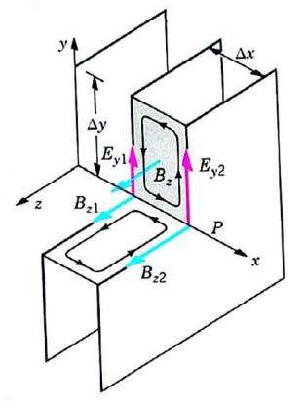
Derivation of the Wave Equation (III)
∫ B ⋅ dl = (−B_{z 2} + B_{z1} )Δz
Φ _{E} = E_{y} ΔxΔz ∴
∂Φ
E ₌
∂E
^{y} ΔxΔz
∂t
∂t
(B_{z 2} − B_{z1} )Δz = −μ₀ε₀
∂E_{y}
ΔxΔz
∂t
∂B_{z}
= −μ₀ε ₀
∂E_{y}
(Ampere- Maxwell law)
∂x ∂t
By taking the appropriate derivatives of these two equations, it is straightforward to obtain Maxwell’s wave equation.
∂² B ∂² B
∂² E ∂² E
z
∂x²
= μ₀ε₀
z
∂t ²
,
y
∂x²
= μ₀ε₀
y
∂t ²
15
Electromagnetic Waves
We saw that a wave traveling along the x-axis with a wave speed v satisfies the wave equation:
∂² y 1 ∂² y
∂x²
=
_{v}2
∂t ²
From Faraday’s law and Ampere-Maxell law, we can derive the following equations:
∂² B ∂² B
∂² E ∂² E
z
∂x²
= μ₀ε₀
z
∂t ²
,
y
∂x²
= μ₀ε₀
y
∂t ²
On comparing these with standard wave equation, we see that the wave speed is
c =
1
(μ = 4π ×10⁻⁷ H/m and ε = 8.55×10⁻¹² F/m)
0 0
μ₀ε ₀
= 3.00 ×10⁸ m/s (speed of light in vacuum)
16

Slide 9
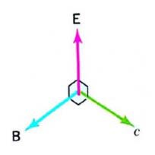
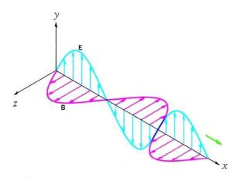
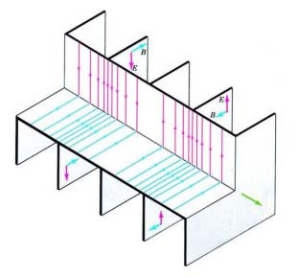
Electromagnetic Waves (II)
The simplest solution of the wave equations are plane wave
∂² B ∂² B
∂
_{x}2
z
= μ₀ε ₀
∂
_{t} 2
z
, B_{z} = B₀ sin(kx − ωt)
∂² E
y
∂² E
y
= μ₀ε₀ , E_{y} = E₀ sin(kx − ωt)
∂x² ∂t ²
The electric E and magnetic B are in phase and are perpendicular to each other and also perpendicular to the direction of propagation.
17
Electromagnetic Waves (III)
One representation of an electromagnetic wave traveling along the +x direction.
A representation of a plane electromagnetic wave in which the variation in the field strengths is depicted by the density of the field lines.
18

Slide 10
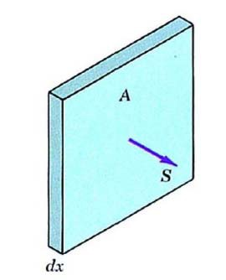
Energy Transport and the Poynting Vector
The energy density of the electric and magnetic fields in free space are given.
1 1
u_{E} = ε E ; u
2 2
0
B
= B
2
2μ₀
Since E = cB =
1
B ⇒ u_{E} = u_{B}
μ₀ε ₀
The total energy density is therefore
2
^{ε 0} EB
u = ε E ² = ^{B} =
0
μ
0
μ
0
19
Energy Transport and the Poynting Vector (II)
Consider two planes, each of area A, a distance dx apart, and normal to the direction of propagation of the wave. The total energy in the volume between the planes is dU=uAdx.
The rate at which this energy through a unit area normal to the direction of propagation is
S = ^{1 dU} = ¹ uA ^{dx} = uc A dt A dt
S = uc = ^{EB}
μ₀
The vector form of the Poynting vector is
_{S =} E × B
μ₀
20

Slide 11
Energy Transport and the Poynting Vector (III)
The magnitude of S is the intensity, that is instantaneous power that across a unit area normal to the direction of the propagation.
The direction of S is the direction of the energy flow.
In an electromagnetic wave, the magnitude of S fluctuates rapidly in time. Thus a more useful quantity, the average intensity, is
S = u
_{c =} EB
av av
2μ₀
The quantity S_{av}, measured in W/m² is the average power incident per unit area normal to the direction of propagation.
21
Example:
A radio station transmits a 10-kW signal at a frequency of 100 MHz. For simplicity, assume that it radiates as a point source. At a distance of 1 km from the antenna, find: (a) the amplitude of the electric and magnetic field strengths, and (b) the energy incident normally on a square plate of side 10 cm in 5 min.
Solution:
₌ Average power ₌ E
2
0
(a) S
av
2
4π r
2μ₀c
⇒
10000
× 2 × 4π ×10⁻⁷ × 3×10⁸ = E ²
4π1000²
0
⎧E₀ = 0.775 V/m
⎨
B = 2.58×10⁻⁹ T
⎩ 0
(b) ΔU = S Δt = 2.4 ×10⁻³ J
av
22

Slide 12
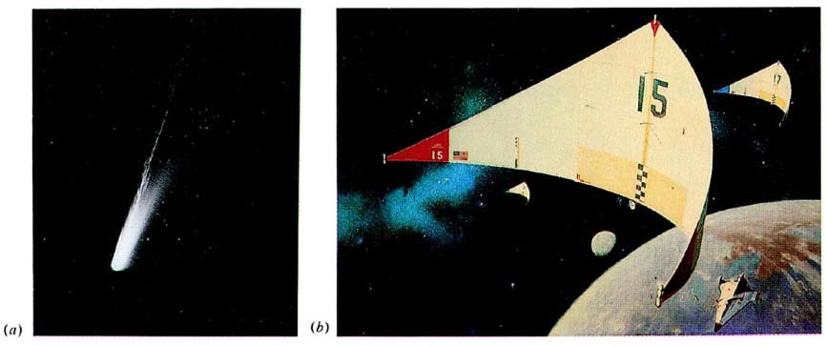
Momentum and Radiation Pressure
An electromagnetic wave transports linear momentum.
We state, without proof, that the linear momentum carried by an electromagnetic wave is related the energy it transport according to
p =
U
c
If surface is perfectly reflecting, the momentum change of the wave is double, consequently, the momentum imparted to the surface is also doubled.
The force exerted by an electromagnetic wave on a surface may be related to the Poynting vector
F ₌ Δp ₌ ΔU ₌ SA ₌ S _{= u} A AΔt AcΔt Ac c
23
Momentum and Radiation Pressure (II)
The radiation pressure at normal incident is
^{F} = ^{S} = u A c
Examples: (a) the tail of comet, (b) A “solar sail”
24

Slide 13
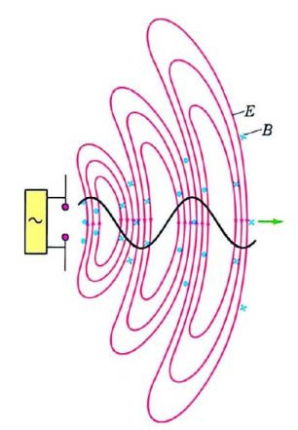
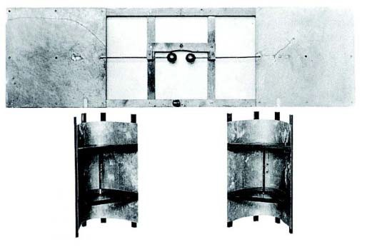
Hertz’s Experiment
When Maxwell’s work was published in 1867 it did not receive immediate acceptance. It is Hertz who conclusively demonstrated the existence of electromagnetic wave.
25
The Electromagnetic Spectrum
Electromagnetic waves span an immerse range of frequencies, from very long wavelength to extremely high energy r-way with frequency 10²³ Hz. There is no theoretical limit to the high end.
26

Slide 14
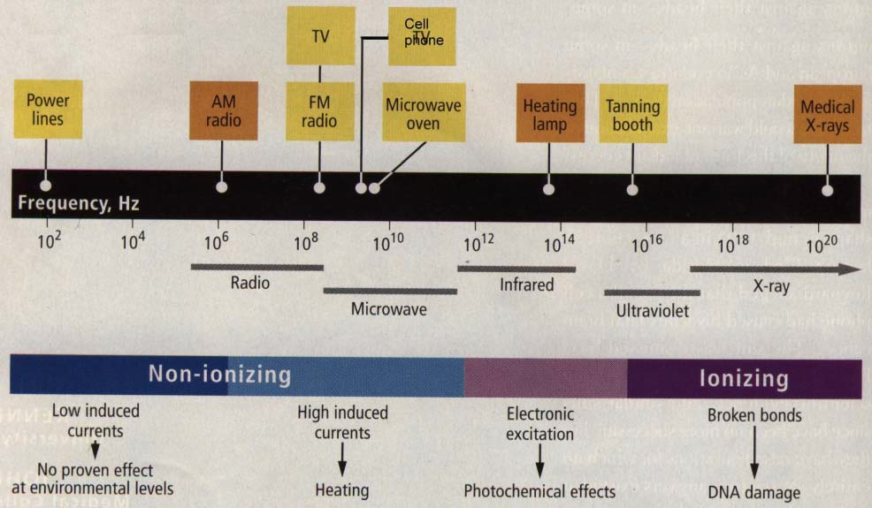
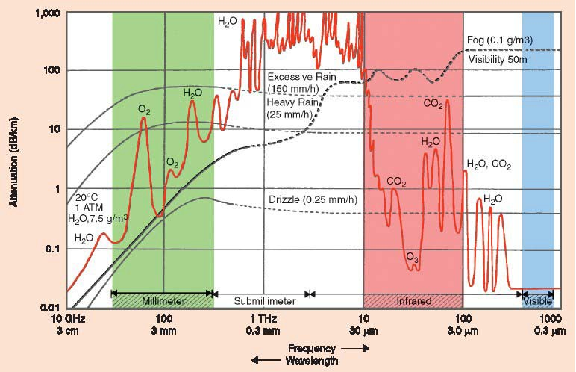
Mainly Heating Effect in Micro/mm-Wave Spectrum
27
Windows for Research and Application Opportunities
28

Slide 15
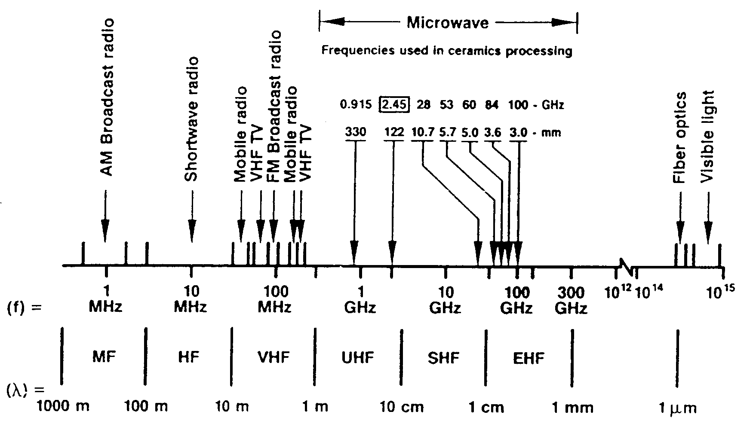
Spectrum to Be Exploited
29
30

